Slide 1
Unsupervised Learning -Clustering
Algorithm
Different Types Of Clustering

Slide 2
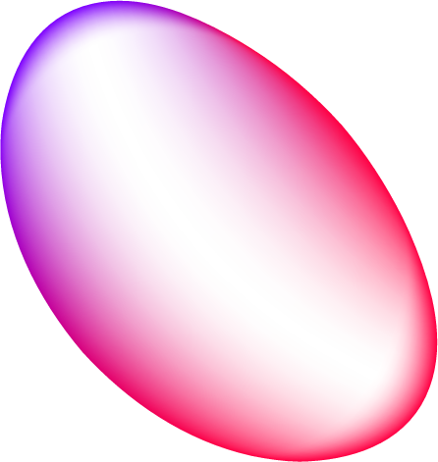
01
Clustering

Slide 3
Problem
Solution -
How to personalise and target marketing in big business?
How to check which news is fake and which is not ?
You have the junk folder in your email box, how does it identify which one is spam and which one is not ?
How to identify the fraudulent taxi driver ?
In football or any sports , who should you have in your team? Which player is going to perform best in your team and help you to beat the competition ?
Clustering

Slide 4

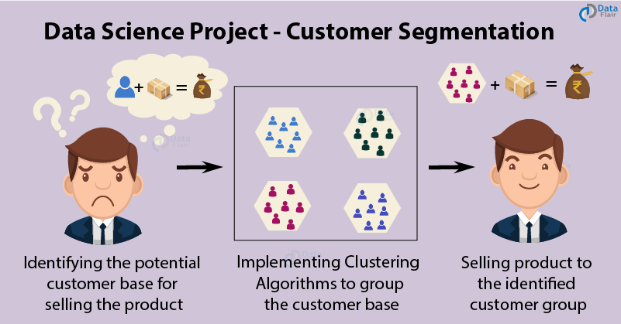
What is Clustering ?
The clustering algorithm is an unsupervised method, where the input is not a labeled one and problem solving is based on the experience that the algorithm gains out of solving similar problems as a training schedule.

Slide 5
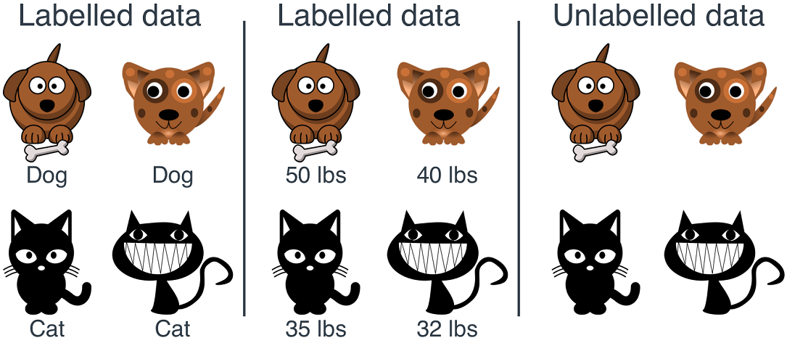
Unsupervised learning means you have a data set that is completely unlabeled. You don’t know if there are any patterns hidden in the data, so you leave it to the algorithm to find anything it can.

Slide 6
Real Life applications of Clustering
Marketing: It can be used to characterize & discover customer segments for marketing purposes.
Biology: It can be used for classification among different species of plants and animals.
Libraries: It is used in clustering different books on the basis of topics and information.
Insurance: It is used to acknowledge the customers, their policies and identifying the frauds.
City Planning: It is used to make groups of houses and to study their values based on their geographical locations and other factors present.
Earthquake studies: By learning the earthquake-affected areas we can determine the dangerous zones.

Slide 7
When To Use Clustering ?
When you’re starting from a large, unstructured data set
When you don’t know how many or which classes your data is divided into
When manually dividing and annotating your data is too resource-intensive
When you’re looking for anomalies in your data

Slide 8
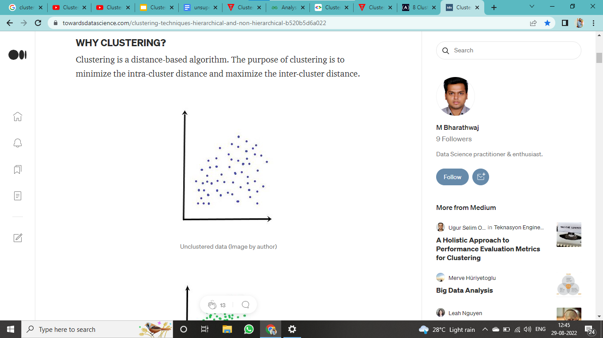
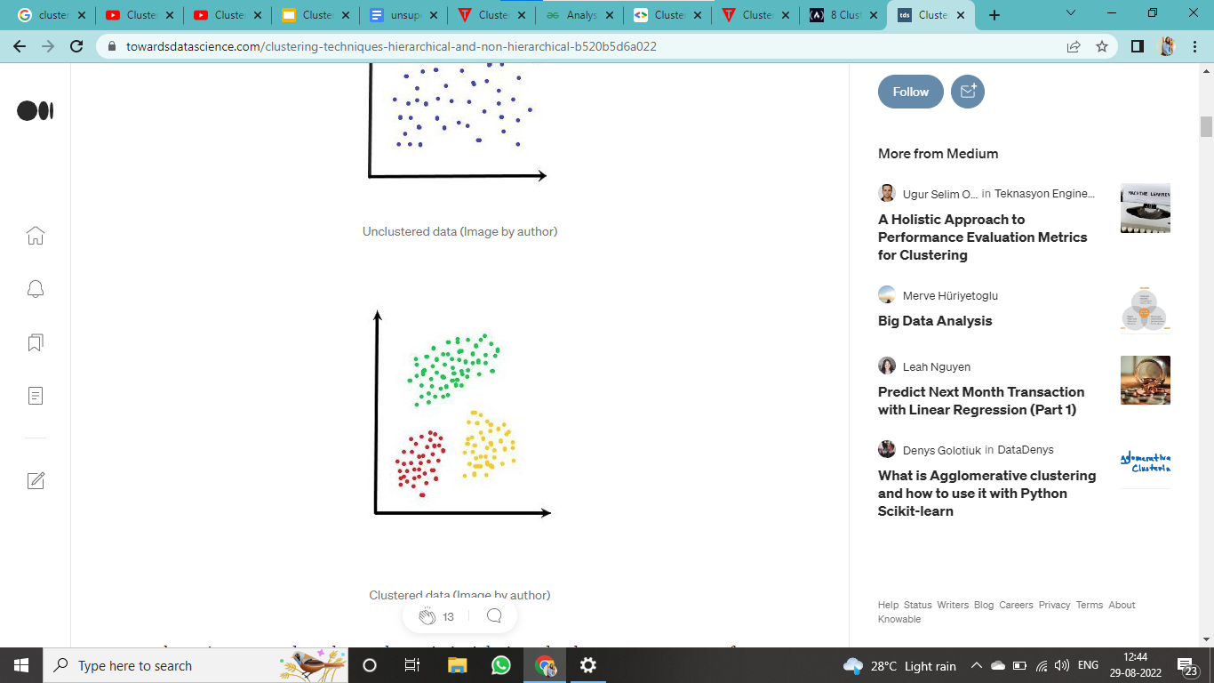
Why Clustering ?
Clustering is a distance-based algorithm. The purpose of clustering is to minimize the intra-cluster distance and maximize the inter-cluster distance.
Clustering as a tool can be used to gain insight into the data. Huge amount of information can be obtained by visualizing the data.
The output of the clustering can also be used as a pre-processing step for other algorithms.
There are several use cases of this technique that is used widely — some of the important ones are market segmentation, customer segmentation, image processing

Slide 9
Mathematics Prerequisite
Covariance Matrix
Singular Value Decomposition

Slide 10
Covariance Matrix
Covariance measures how much two random variables vary together in a population. When the population contains higher dimensions or more random variables, a matrix is used to describe the relationship between different dimensions.
In a more easy-to-understand way, covariance matrix is to define the relationship in the entire dimensions as the relationships between every two random variables.

Slide 11
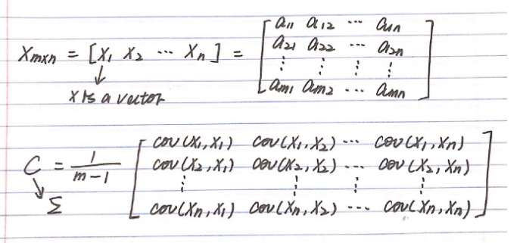
Diagram

Slide 12
Singular Value Decomposition
You just need to know four things to understand the applications:
SVD is the decomposition of a matrix A into 3 matrices – U, S, and V.
S is the diagonal matrix of singular values. Think of singular values as the importance values of different features in the matrix
The rank of a matrix is a measure of the unique information stored in a matrix. Higher the rank, more the information
Eigenvectors of a matrix are directions of maximum spread or variance of data
In most of the applications of SVD, the basic principle of Dimensionality Reduction is used. You want to reduce a high-rank matrix to a low-rank matrix while preserving important information.

Slide 13
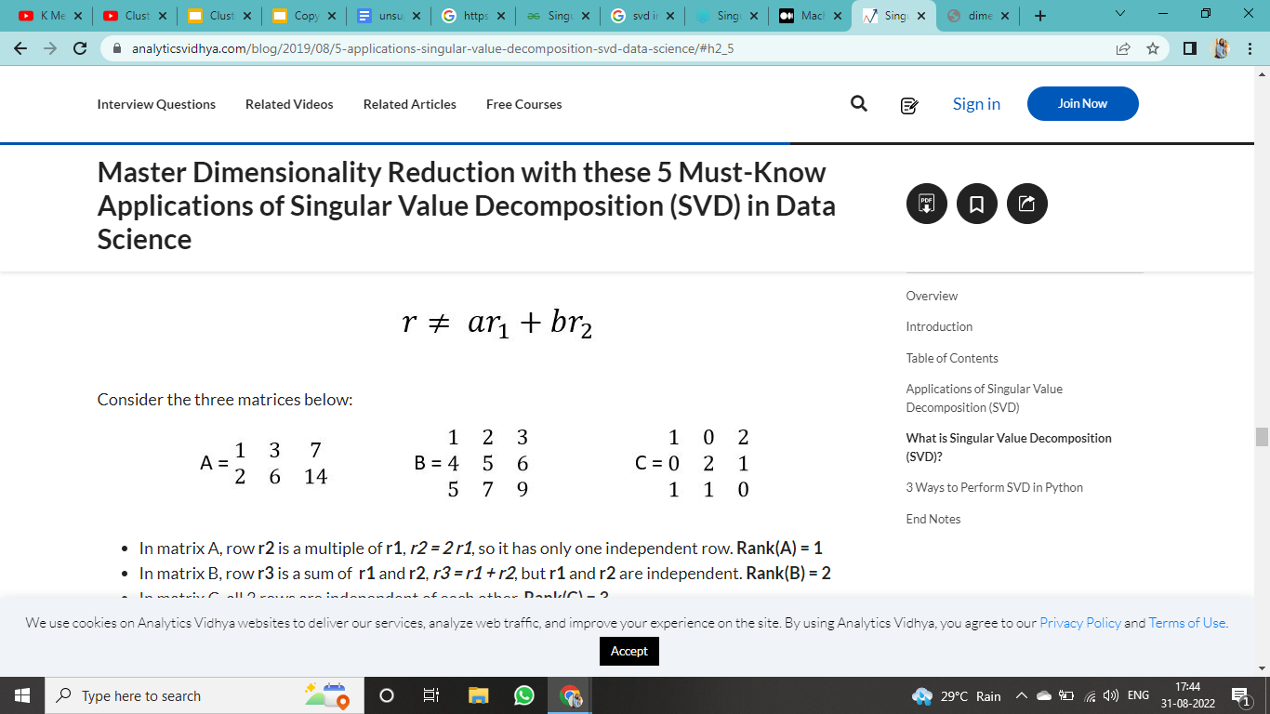
Rank Of Matrix
Before SVD , we need to know rank of matrix
The rank of a matrix is the maximum number of linearly independent row (or column) vectors in the matrix. A vector r is said to be linearly independent of vectors r1 and r2 if it cannot be expressed as a linear combination of r1 and r2.

Slide 14
Consider the three matrix below :
In matrix A, row r2 is a multiple of r1, r2 = 2 r1, so it has only one independent row. Rank(A) = 1
In matrix B, row r3 is a sum of r1 and r2, r3 = r1 + r2, but r1 and r2 are independent. Rank(B) = 2
In matrix C, all 3 rows are independent of each other. Rank(C) = 3
The rank of a matrix can be thought of as a representative of the amount of unique information represented by the matrix. Higher the rank, higher the information

Slide 15
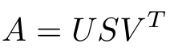
Singular Value Decomposition
So where does SVD fit into the overall picture? SVD deals with decomposing a matrix into a product of 3 matrices as shown:
If the dimensions of A are m x n:
U is an m x m matrix of Left Singular Vectors
S is an m x n rectangular diagonal matrix of Singular Values arranged in decreasing order
V is an n x n matrix of Right Singular Vectors

Slide 16
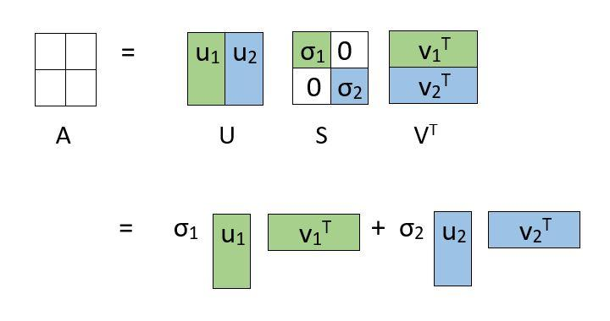
Why is SVD used in Dimensionality Reduction ?

Slide 17
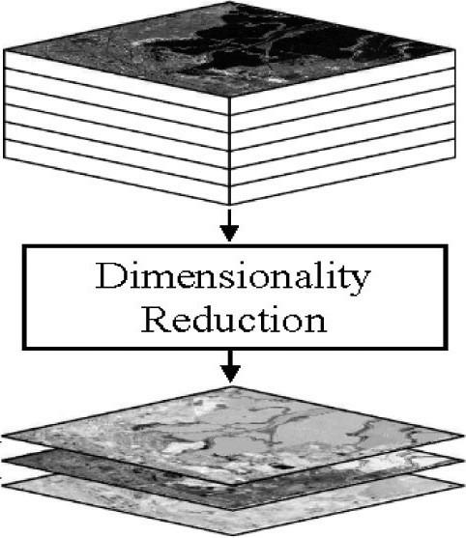
What is Dimensionality Reduction ?
Dimensionality reduction is the process of reducing the number of random variables under consideration, by obtaining a set of principal variables. It can be divided into feature selection and feature extraction.

Slide 18
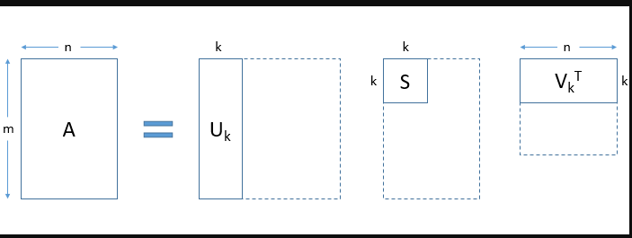
The decomposition allows us to express our original matrix as a linear combination of low-rank matrices.
In a practical application, you will observe that only the first few, say k, singular values are large. The rest of the singular values approach zero. As a result, terms except the first few can be ignored without losing much of the information. See how the matrices are truncated in the figure below:

Slide 19
To summarize:
Using SVD, we are able to represent our large matrix A by 3 smaller matrices U, S and V.
This is helpful in large computations.
We can obtain a k-rank approximation of A. To do this, select the first k singular values and truncate the 3 matrices accordingly.
Singular Value Decomposition(SVD) is one of the most widely used Unsupervised learning algorithms, that is at the center of many recommendation and Dimensionality reduction systems that are the core of global companies such as Google, Netflix, Facebook, Youtube, and others.

Slide 20
Types of Clustering
There are a variety of clustering algorithms, but some of the most common are -
K-means clustering,
Hierarchical clustering and
Density-based clustering.

Slide 21
K-means Clustering

Slide 22
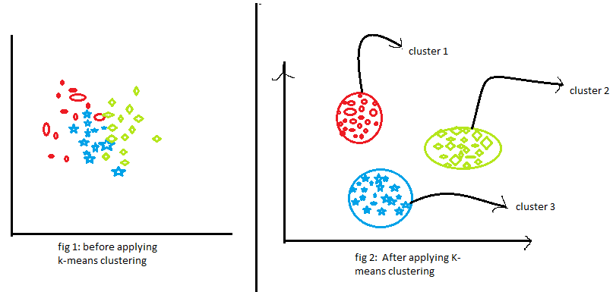

Slide 23
Definition
K-means clustering is the most commonly used clustering algorithm.This algorithm tries to minimize the variance of data points within a cluster. It's also how most people are introduced to unsupervised machine learning.
It fall in Partitioning clustering type meaning it is a type of clustering that divides the data into non-hierarchical groups. It is also known as the centroid-based method.
K-means is best used on smaller data sets because it iterates over all of the data points. That means it'll take more time to classify data points if there are a large amount of them in the data set.
k-Means clustering algorithm proposed by J. Hartigan and M. A. Wong [1979].

Slide 24
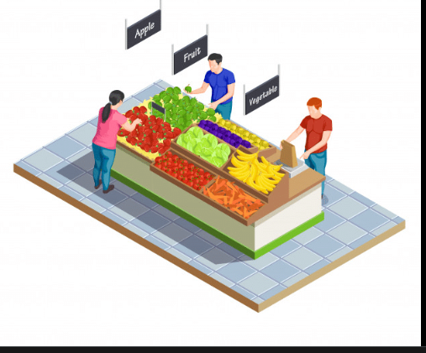
Real Life Application
Automatic clustering of IT alerts
Wireless sensor
Delivery store optimization
Document classification
Identifying crime localities
Customer/Market Segmentation
Fantasy league stat analysis
Insurance fraud detection
Call record detail analysis
Cyber-profiling criminals,etc.

Slide 25
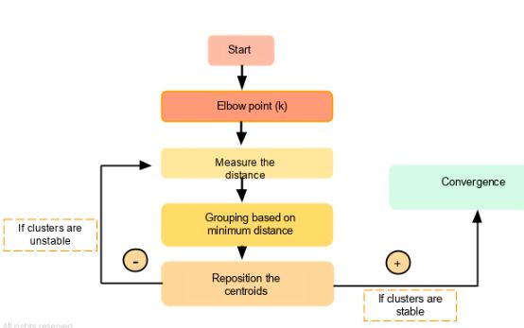
Algorithm

Slide 26
Input: D is a dataset containing n objects, k is the number of cluster
Output: A set of k clusters
Steps:
1.Randomly choose k objects from D as the initial cluster centroids.
2.For each of the objects in D do
•Compute distance between the current objects and k cluster centroids
•Assign the current object to that cluster to which it is closest.
3.Compute the “cluster centers” of each cluster. These become the new cluster centroids.
4.Repeat step 2-3 until the convergence criterion is satisfied
5.Stop

Slide 27
Step wise
The algorithm can be stated as follows.
First it selects k number of objects at random from the set of n objects. These k objects are treated as the centroids or center of gravities of k clusters.
For each of the remaining objects, it is assigned to one of the closest centroid. Thus, it forms a collection of objects assigned to each centroid and is called a cluster.
Next, the centroid of each cluster is then updated (by calculating the mean values of attributes of each object).
The assignment and update procedure is until it reaches some stopping criteria (such as, number of iteration, centroids remain unchanged or no assignment, etc.)

Slide 28
Notes -
1)Objects are defined in terms of set of attributes. 〖A={A〗_1,A_2,…..,A_m} where each A_i is continuous data type.
2)Distance computation: Any distance such as L_1,L_2,L_3 or cosine similarity.
3)Minimum distance is the measure of closeness between an object and centroid.
4)Mean Calculation: It is the mean value of each attribute values of all objects.
5)Convergence criteria: Any one of the following are termination condition of the algorithm.
Number of maximum iteration permissible.
No change of centroid values in any cluster.
Zero (or no significant) movement(s) of object from one cluster to another.
Cluster quality reaches to a certain level of acceptance.

Slide 29
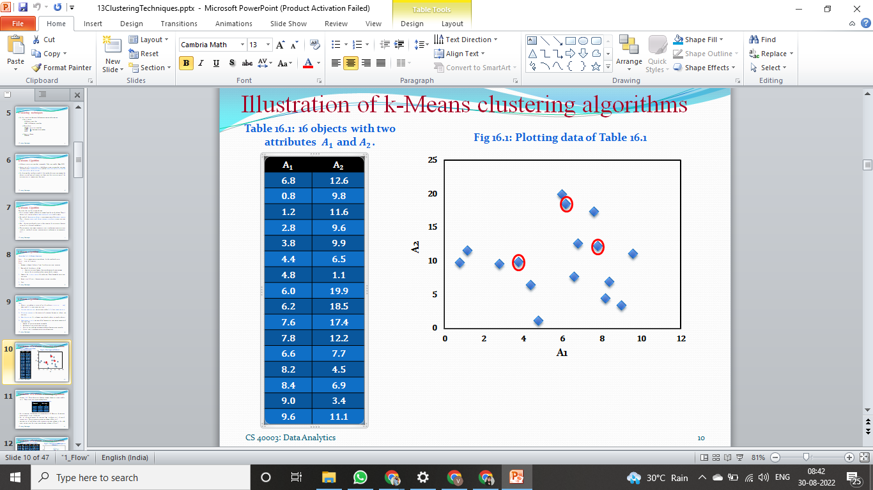
Illustration
Table : Objects with two attributes A_1 and A_2
Plotting data of Table

Slide 30
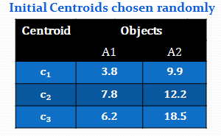
Suppose, k=3. Three objects are chosen at random shown as circled . These three centroids are shown below.
Initial Centroids chosen randomly
Let us consider the Euclidean distance measure (L₂ Norm) as the distance measurement in our illustration.
Let d₁, d₂ and d₃ denote the distance from an object to c₁, c₂ and c₃ respectively. The distance calculations are shown in Table 16.2.
Assignment of each object to the respective centroid is shown in the right-most column and the clustering so obtained .

Slide 31
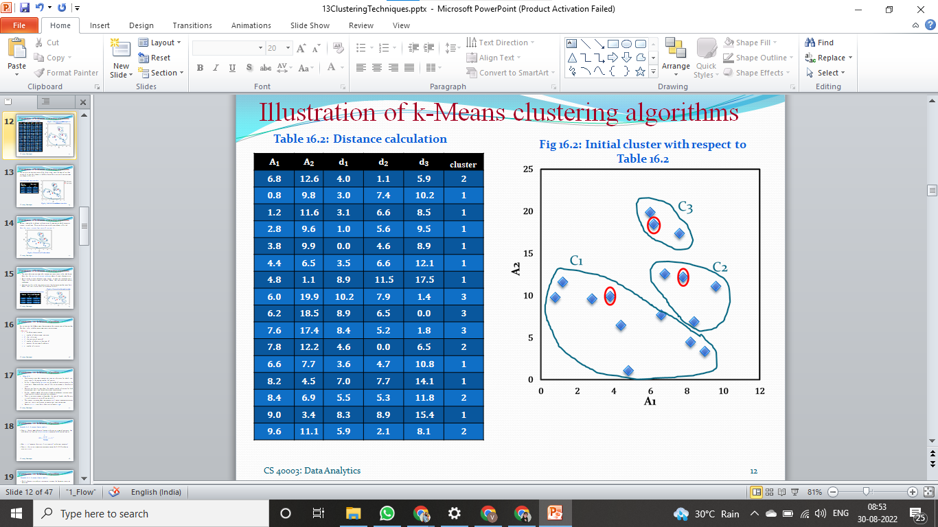
Distance calculation
Initial cluster with respect to Table

Slide 32
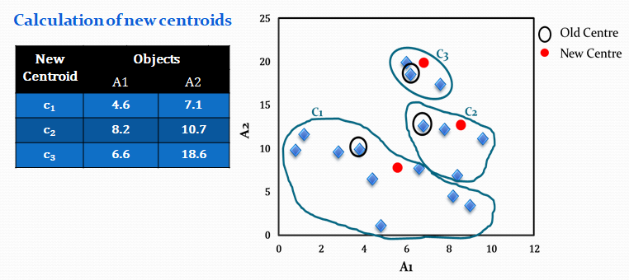
The calculation new centroids of the three cluster using the mean of attribute values of A₁ and A₂ is shown in the Table below. The cluster with new centroids are shown in Fig.
Initial Cluster with new centroid

Slide 33
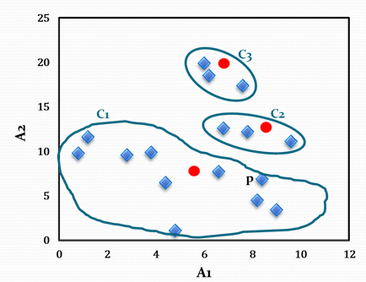
We next reassign the 16 objects to three clusters by determining which centroid is closest to each one. This gives the revised set of clusters shown in Fig.
Note that point p moves from cluster C₂ to cluster C₁.
Cluster after first iteration

Slide 34
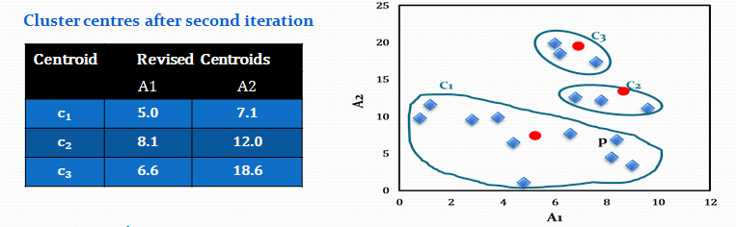
•The newly obtained centroids after second iteration are given in the table below. Note that the centroid c₃ remains unchanged, where c₂ and c₁ changed a little.
•With respect to newly obtained cluster centres, 16 points are reassigned again. These are the same clusters as before. Hence, their centroids also remain unchanged.
•Considering this as the termination criteria, the k-means algorithm stops here. Hence, the final cluster in Fig 16.5 is same as Fig 16.4.

Slide 35
Distance Measurement:
•To assign a point to the closest centroid, we need a proximity measure that should quantify the notion of “closest” for the objects under clustering.
•Usually Euclidean distance (L₂ norm) is the best measure when object points are defined in n-dimensional Euclidean space.
•Other measure namely cosine similarity is more appropriate when objects are of document type.
•Further, there may be other type of proximity measures that appropriate in the context of applications.
•For example, Manhattan distance (L₁ norm), Jaccard measure, etc.

Slide 36
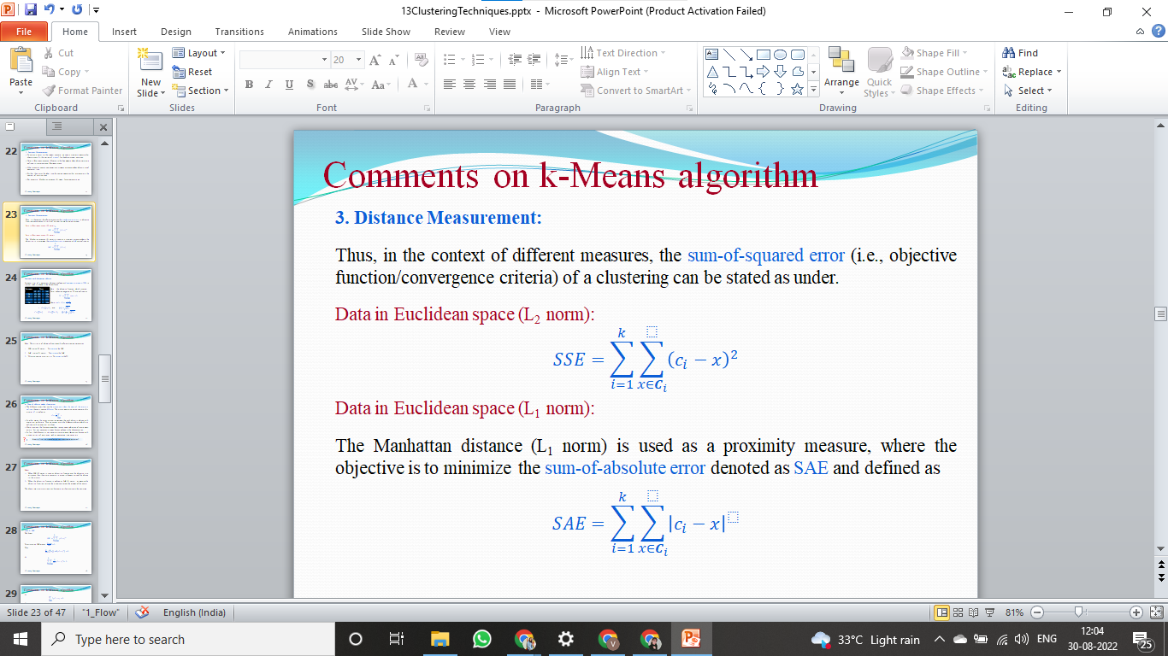
Distance Measurement:
in the context of different measures, the sum-of-squared error (i.e., objective function/convergence criteria) of a clustering can be stated as under.
Data in Euclidean space (L₂ norm):
Data in Euclidean space (L₁ norm):
The Manhattan distance (L₁ norm) is used as a proximity measure, where the objective is to minimize the sum-of-absolute error denoted as SAE and defined as

Slide 37
Determining The Optimal Number Of Clusters: 3 Must Know Methods
Determining the optimal number of clusters in a data set is a fundamental issue in partitioning clustering, such as k-means clustering, which requires the user to specify the number of clusters k to be generated.
Unfortunately, there is no definitive answer to this question. The optimal number of clusters is somehow subjective and depends on the method used for measuring similarities and the parameters used for partitioning.

Slide 38
A simple and popular solution consists of inspecting the dendrogram produced using hierarchical clustering to see if it suggests a particular number of clusters. Unfortunately, this approach is also subjective.
These methods include direct methods and statistical testing methods:
Direct methods: consists of optimizing a criterion, such as the within cluster sums of squares or the average silhouette. The corresponding methods are named elbow and silhouette methods, respectively.
Statistical testing methods: consists of comparing evidence against null hypothesis. An example is the gap statistic.

Slide 39
Elbow
Recall that, the basic idea behind k-means clustering, is to define clusters such that the total intra-cluster variation [or total within-cluster sum of square (WSS)] is minimized. The total WSS measures the compactness of the clustering and we want it to be as small as possible.
The Elbow method looks at the total WSS as a function of the number of clusters: One should choose a number of clusters so that adding another cluster doesn’t improve much better the total WSS.
The optimal number of clusters can be defined as follow:
Compute clustering algorithm (e.g., k-means clustering) for different values of k. For instance, by varying k from 1 to 10 clusters.
For each k, calculate the total within-cluster sum of square (wss).
Plot the curve of wss according to the number of clusters k.
The location of a bend (knee) in the plot is generally considered as an indicator of the appropriate number of clusters.
Note that, the elbow method is sometimes ambiguous. An alternative is the average silhouette method.

Slide 40
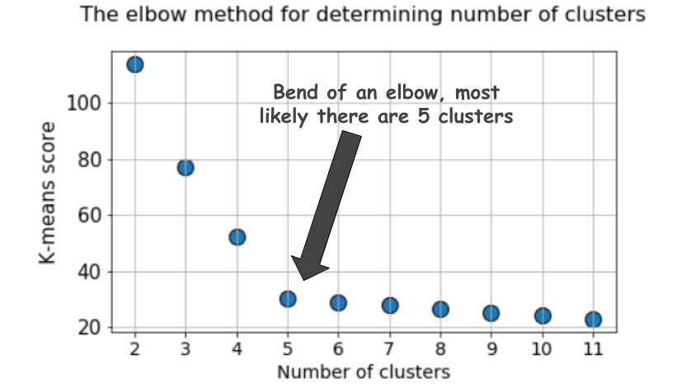
Elbow

Slide 41
Average Silhouette Method
The average silhouette method developed by Kaufman and Rousseeuw [1990] which can be used with any clustering approach.
Basically it determines how well each object lies within a cluster. A high average silhouette width indicates a good clustering.
Average silhouette method computes the average silhouette of observations for different values of k. The optimal number of clusters k is the one that maximize the average silhouette over a range of possible values for k.
The algorithm is similar to the elbow method and can be computed as follow:
Compute clustering algorithm (e.g., k-means clustering) for different values of k. For instance, by varying k from 1 to 10 clusters.
For each k, calculate the average silhouette of observations (avg.sil).
Plot the curve of avg.sil according to the number of clusters k.
The location of the maximum is considered as the appropriate number of clusters.

Slide 42
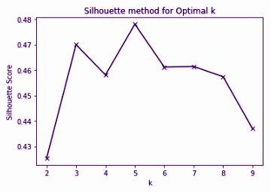
Average Silhouette Method

Slide 43
Gap Statistics
The gap statistic has been published by R. Tibshirani, G. Walther, and T. Hastie (Stanford University, 2001). The approach can be applied to any clustering method.
The gap statistic compares the total within intra-cluster variation for different values of k with their expected values under null reference distribution of the data. The estimate of the optimal clusters will be value that maximize the gap statistic (i.e, that yields the largest gap statistic). This means that the clustering structure is far away from the random uniform distribution of points.

Slide 44
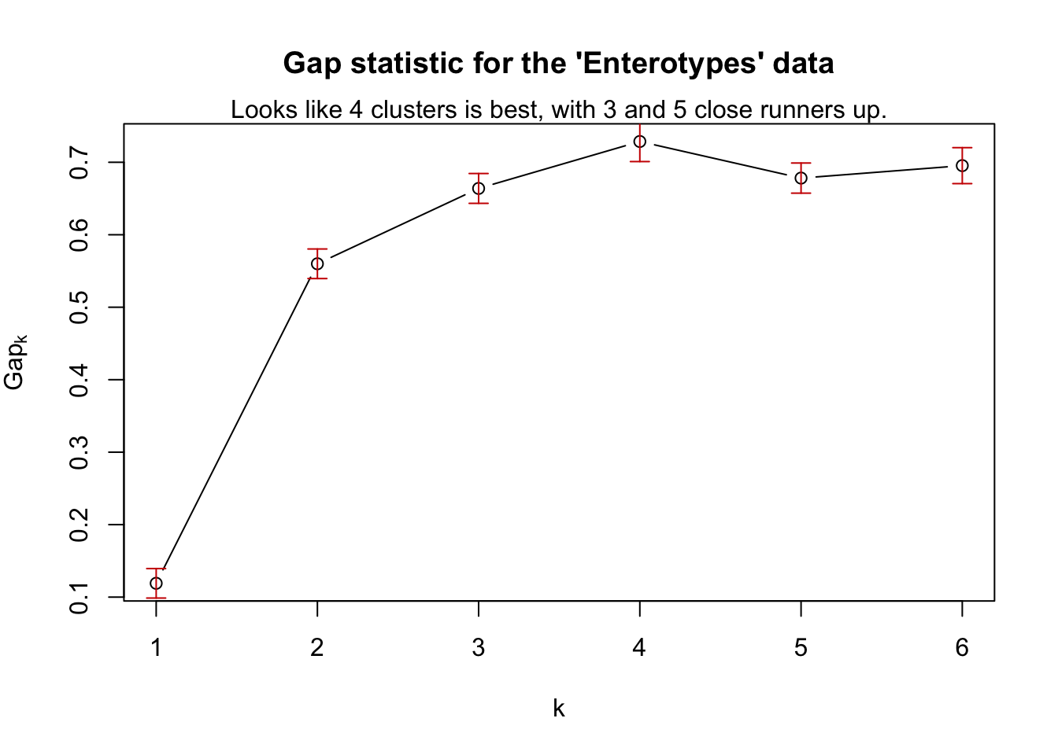
Gap Statistics

Slide 45
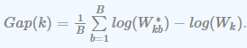
The algorithm works as follow:
Cluster the observed data, varying the number of clusters from k = 1, …, k_{max}, and compute the corresponding total within intra-cluster variation W_{k}.
Generate B reference data sets with a random uniform distribution. Cluster each of these reference data sets with varying number of clusters k = 1, …, k_{max}, and compute the corresponding total within intra-cluster variation W_{kb}.
Compute the estimated gap statistic as the deviation of the observed W_{k} value from its expected value W_{kb} under the null hypothesis:
Compute also the standard deviation of the statistics.
Choose the number of clusters as the smallest value of k such that the gap statistic is within one standard deviation of the gap at k+1: Gap(k)≥Gap(k + 1)−s_{k + 1}.

Slide 46
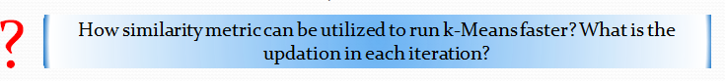
Advantage
k-Means is simple and can be used for a wide variety of object types.
It is also efficient both from storage requirement and execution time point of views. By saving distance information from one iteration to the next, the actual number of distance calculations, that must be made can be reduced (specially, as it reaches towards the termination).

Slide 47
Disadvantage
The k-Means is not suitable for all types of data. For example, k-Means does not work on categorical data because mean cannot be defined.
k-means finds a local optima and may actually minimize the global optimum.
k-Means algorithm cannot handle non-globular clusters, clusters of different sizes and densities.
k-Means algorithm not really beyond the scalability issue (and not so practical for large databases).

Slide 48
Hierarchical Clustering

Slide 49
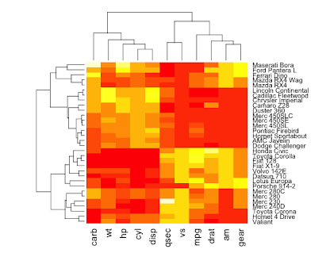

Slide 50
Definition
Hierarchical-based clustering is typically used on hierarchical data, like you would get from a company database or taxonomies. It builds a tree of clusters so everything is organized from the top-down and the tree structure look alike a dendrogram.
This is more restrictive than the other clustering types, but it's perfect for specific kinds of data sets.
Records in the data set are grouped sequentially to form clusters based on distance between the records and also the distance between the clusters.
Fun fact - Hierarchical Clustering is often associated with Heatmaps.

Slide 51
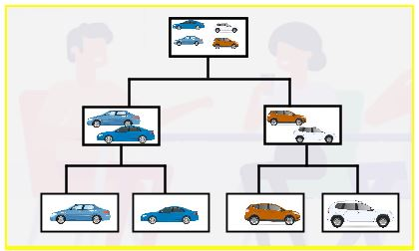
Applications In Real Life
Bioinformatics: grouping animals according to their biological features to reconstruct phylogeny trees.
Business: dividing customers into segments or forming a hierarchy of employees based on salary.
Image processing: grouping handwritten characters in text recognition based on the similarity of the character shapes.
Information Retrieval: categorizing search results based on the query.
US Senator Clustering through Twitter.
Charting Evolution through Phylogenetic Trees.
Tracking Viruses through Phylogenetic Trees,etc.

Slide 52
This clustering technique is divided into two types:
Agglomerative Hierarchical Clustering
Divisive Hierarchical Clustering

Slide 53
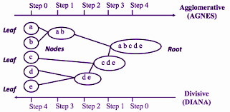
Diagram

Slide 54
Agglomerative Hierarchical Clustering
The Agglomerative Hierarchical Clustering is the most common type of hierarchical clustering used to group objects in clusters based on their similarity. It’s also known as AGNES (Agglomerative Nesting). It's a “bottom-up” approach: each observation starts in its own cluster, and pairs of clusters are merged as one moves up the hierarchy.
Algorithm -
Make each data point a single-point cluster → forms N clusters
Take the two closest data points and make them one cluster → forms N-1 clusters
Take the two closest clusters and make them one cluster(Merge) → Forms N-2 clusters
Update the distance matrix.
Repeat step-3 until you are left with only one cluster.

Slide 55
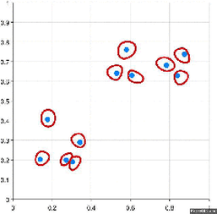
Visual representation of Agglomerative Hierarchical Clustering

Slide 56
There are several ways to measure the distance between clusters in order to decide the rules for clustering, and they are often called Linkage Methods. Some of the common linkage methods are:
Complete-linkage: the distance between two clusters is defined as the longest distance between two points in each cluster.
Single-linkage: the distance between two clusters is defined as the shortest distance between two points in each cluster. This linkage may be used to detect high values in your dataset which may be outliers as they will be merged at the end.
Average-linkage: the distance between two clusters is defined as the average distance between each point in one cluster to every point in the other cluster.
Centroid-linkage: finds the centroid of cluster 1 and centroid of cluster 2, and then calculates the distance between the two before merging.

Slide 57
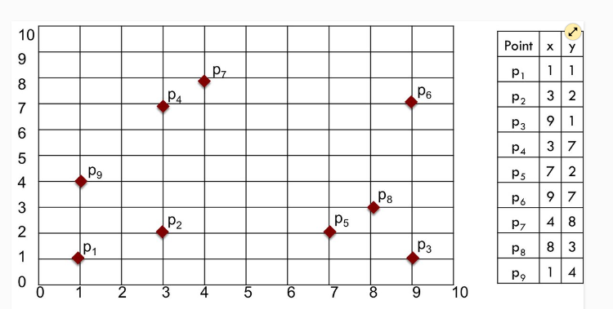
A numerical example will help illustrate the methods and choices. We'll use a small sample data set containing just nine two-dimensional points

Slide 58
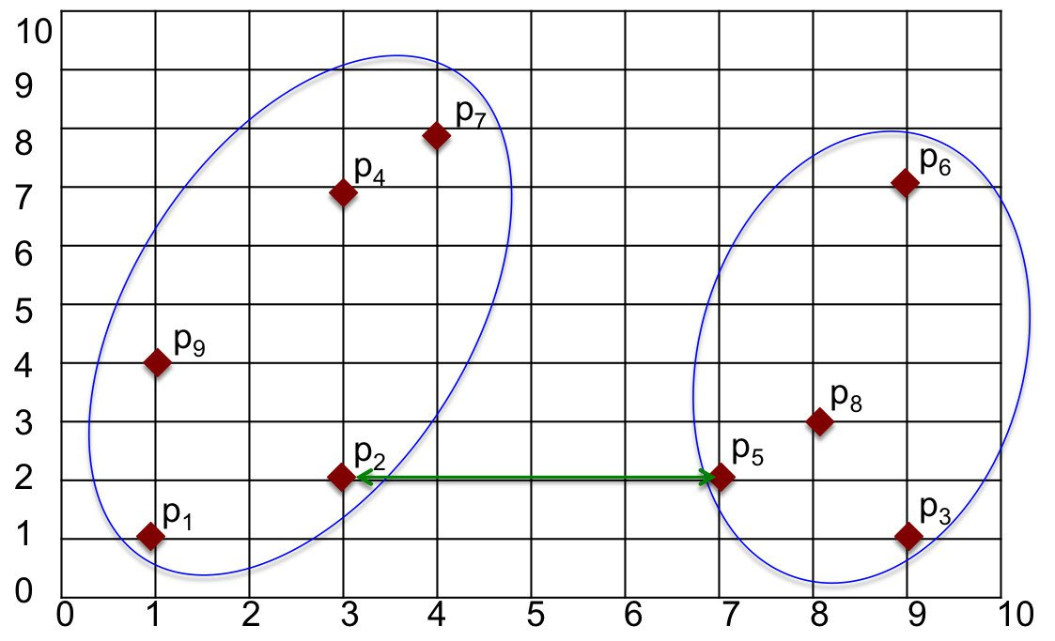
1. Single Linkage
One way to measure the distance between clusters is to find the minimum distance between points in those clusters. That is, we can find the point in the first cluster nearest to a point in the other cluster and calculate the distance between those points. The closest points are p2 in one cluster and p5 in the other. The distance between those points, and hence the distance between clusters, is found as d(p2,p5)=4.
The advantage of the Min method is that it can accurately handle non-elliptical shapes. The disadvantages are that it is sensitive to noise and outliers.

Slide 59
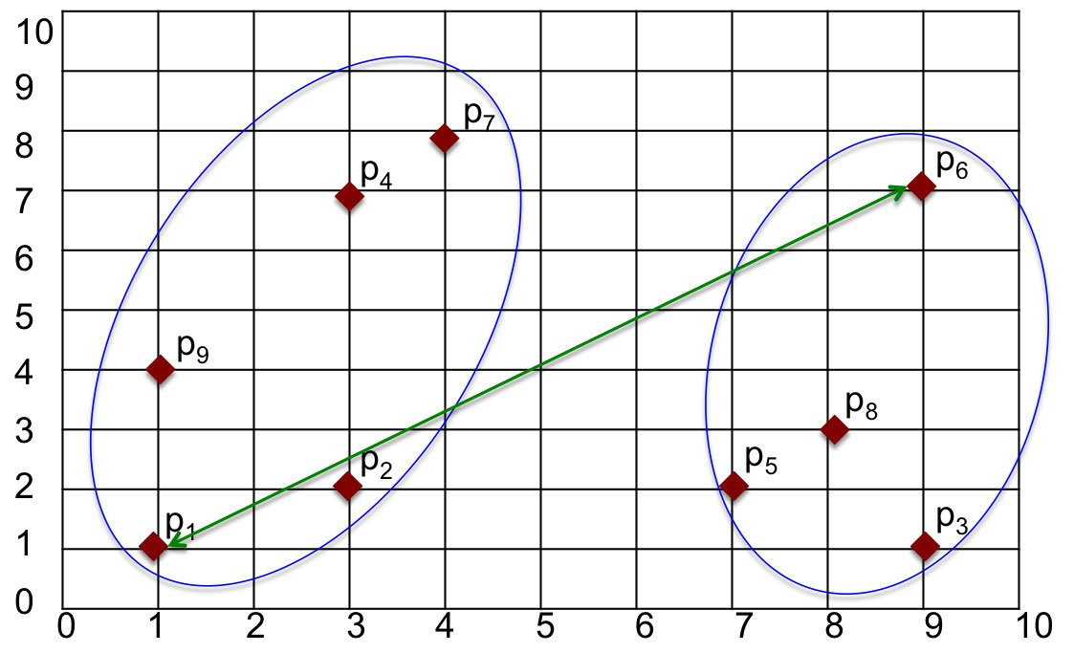
2. Complete Linkage
Another way to measure the distance is to find the maximum distance between points in two clusters. We can find the points in each cluster that are furthest away from each other and calculate the distance between those points. The maximum distance is between p1 and p6. Distance between those two points, and hence the distance between clusters, is found as d(p1,p6)=10.
Max is less sensitive to noise and outliers in comparison to MIN method. However, MAX can break large clusters and tends to be biased towards globular clusters.

Slide 60
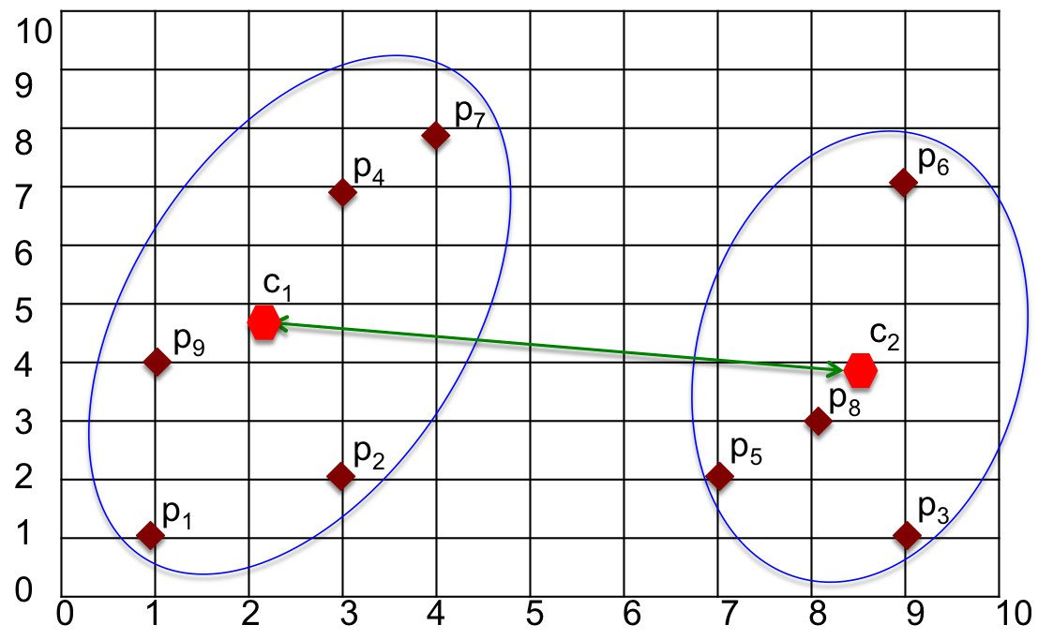
3. Centroid Method
The Centroid method defines the distance between clusters as being the distance between their centers/centroids. After calculating the centroid for each cluster, the distance between those centroids is computed using a distance function.

Slide 61
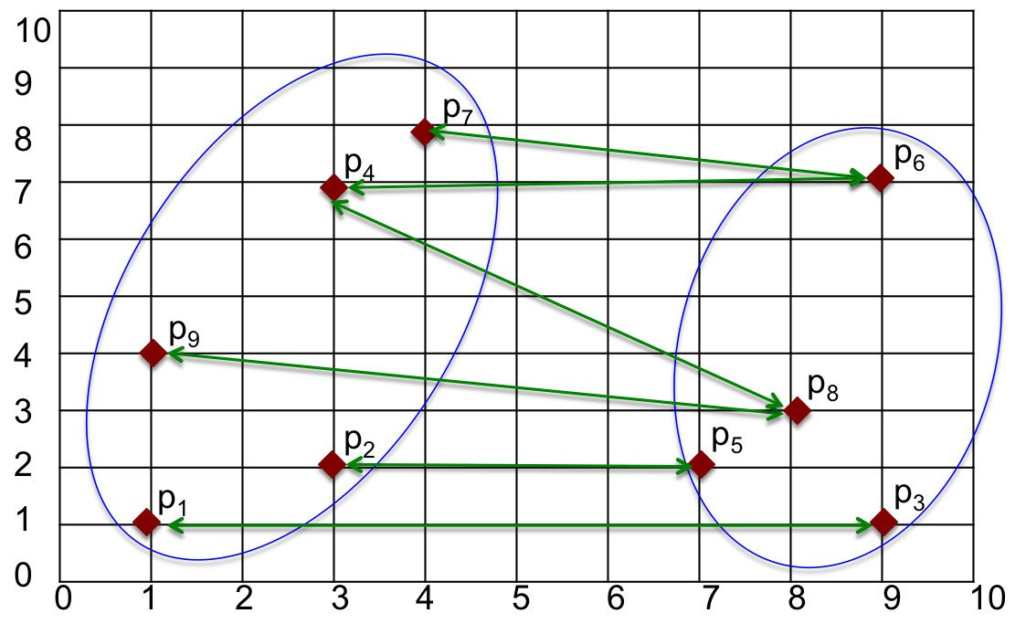
4.Average Method
The Average method defines the distance between clusters as the average pairwise distance among all pairs of points in the clusters. For simplicity, only some of the lines connecting pairs of points are shown .

Slide 62
The choice of linkage method entirely depends on you and there is no hard and fast method that will always give you good results. Different linkage methods lead to different clusters.
The point of doing all this is to demonstrate the way hierarchical clustering works, it maintains a memory of how we went through this process and that memory is stored in Dendrogram.

Slide 63
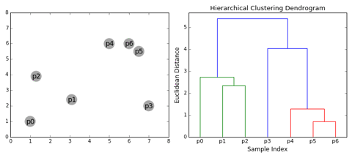
What is dendrogram?
A Dendrogram is a type of tree diagram showing hierarchical relationships between different sets of data.
As already said a Dendrogram contains the memory of hierarchical clustering algorithm, so just by looking at the Dendrogram you can tell how the cluster is formed.

Slide 64
Notes -
Distance between data points represents dissimilarities.
Height of the blocks represents the distance between clusters.
So you can observe from the above figure that initially P5 and P6 which are closest to each other by any other point are combined into one cluster followed by P4 getting merged into the same cluster(C2).
Then P1and P2 gets combined into one cluster followed by P0 getting merged into the same cluster(C4). Now P3 gets merged in cluster C2 and finally, both clusters get merged into one.

Slide 65
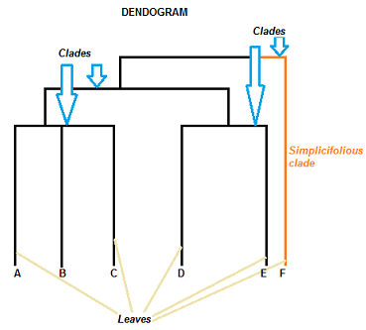
Parts Of Dendrogram

Slide 66
A dendrogram can be a column graph (as in the image below) or a row graph. Some dendrograms are circular or have a fluid-shape, but the software will usually produce a row or column graph. No matter what the shape, the basic graph comprises the same parts:
The Clades are the branch and are arranged according to how similar (or dissimilar) they are. Clades that are close to the same height are similar to each other; clades with different heights are dissimilar — the greater the difference in height, the more dissimilarity.
Each clade has one or more leaves.
Leaves A, B, and C are more similar to each other than they are to leaves D, E, or F.
Leaves D and E are more similar to each other than they are to leaves A, B, C, or F.
Leaf F is substantially different from all of the other leaves.
A clade can theoretically have an infinite amount of leaves. However, the more leaves you have, the harder the graph will be to read with the naked eye.

Slide 67
How to decide when to stop merging the cluster?
You cut the dendrogram tree with a horizontal line at a height where the line can traverse the maximum distance up and down without intersecting the merging point.
For example in the below figure L3 can traverse maximum distance up and down without intersecting the merging points. So we draw a horizontal line and the number of vertical lines it intersects is the optimal number of clusters.

Slide 68
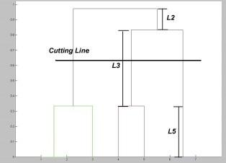
Number of Clusters in this case = 3.

Slide 69
Divisive Hierarchical Clustering
In Divisive or DIANA (DIvisive ANAlysis Clustering) is a top-down clustering method where we assign all of the observations to a single cluster and then partition the cluster to two least similar clusters. Finally, we proceed recursively on each cluster until there is one cluster for each observation. So this clustering approach is exactly opposite to Agglomerative clustering.
There is evidence that divisive algorithms produce more accurate hierarchies than agglomerative algorithms in some circumstances but is conceptually more complex.
In both agglomerative and divisive hierarchical clustering, users need to specify the desired number of clusters as a termination condition(when to stop merging).

Slide 70
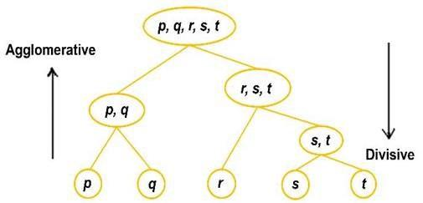
Diagram

Slide 71
Measuring The Goodness Of Clustering
Well, there are many measures to do this, perhaps the most popular one is the Dunn's Index.
Dunn's index is the ratio between the minimum inter-cluster distances to the maximum intra-cluster diameter. The diameter of a cluster is the distance between its two furthermost points. In order to have well separated and compact clusters you should aim for a higher Dunn's index.

Slide 72
Advantage
Disadvantage
Hierarchical clustering is a very useful way of segmentation. The advantage of not having to pre-define the number of clusters gives it quite an edge over k-Means.
It doesn't work well when we have huge amount of data.

Slide 73
Density Based Clustering

Slide 74
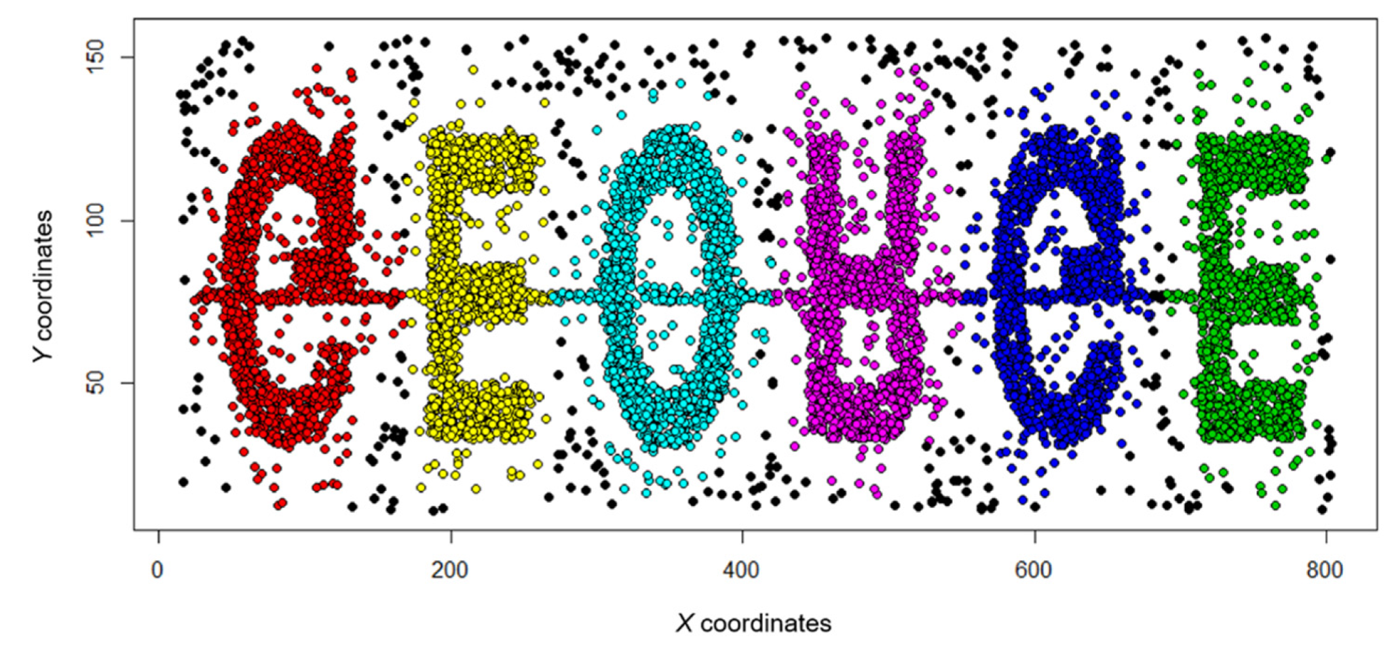
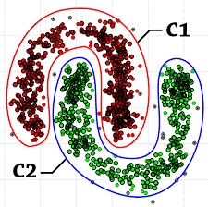
Diagram of DBSCAN

Slide 75
Why do we need a Density-Based clustering algorithm like DBSCAN when we already have K-means clustering?
K-Means clustering may cluster loosely related observations together. Every observation becomes a part of some cluster eventually, even if the observations are scattered far away in the vector space. Since clusters depend on the mean value of cluster elements, each data point plays a role in forming the clusters. A slight change in data points might affect the clustering outcome. This problem is greatly reduced in DBSCAN due to the way clusters are formed. This is usually not a big problem unless we come across some odd shape data.

Slide 76
Another challenge with k-means is that you need to specify the number of clusters (“k”) in order to use it. Much of the time, we won’t know what a reasonable k value is a priori.
What’s nice about DBSCAN is that you don’t have to specify the number of clusters to use it. All you need is a function to calculate the distance between values and some guidance for what amount of distance is considered “close”. DBSCAN also produces more reasonable results than k-means across a variety of different distributions.

Slide 77
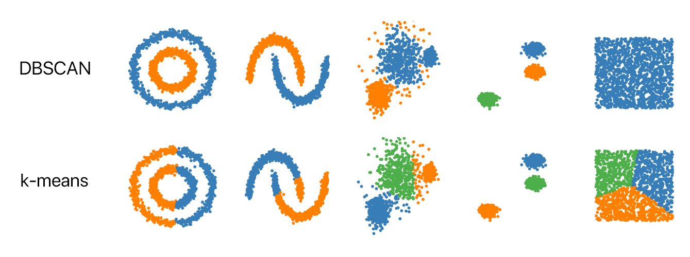
DBSCAN VS K-MEANS

Slide 78
Definition
Density-Based Clustering refers to unsupervised learning methods that identify distinctive groups/clusters in the data, based on the idea that a cluster in data space is a contiguous region of high point density, separated from other such clusters by contiguous regions of low point density.
Density-Based Spatial Clustering of Applications with Noise (DBSCAN) is a base algorithm for density-based clustering. It can discover clusters of different shapes and sizes from a large amount of data, which is containing noise and outliers.

Slide 79
The DBSCAN algorithm uses two parameters:
minPts: The minimum number of points (a threshold) clustered together for a region to be considered dense.
eps (ε): A distance measure that will be used to locate the points in the neighborhood of any point.
These parameters can be understood if we explore two concepts called Density Reachability and Density Connectivity.

Slide 80
Reachability in terms of density establishes a point to be reachable from another if it lies within a particular distance (eps) from it.
Connectivity on the other hand, involves a transitivity based chaining-approach to determine whether points are located in a particular cluster. For example, p and q points could be connected if p->r->s->t->q, where a->b means b is in the neighborhood of a.

Slide 81
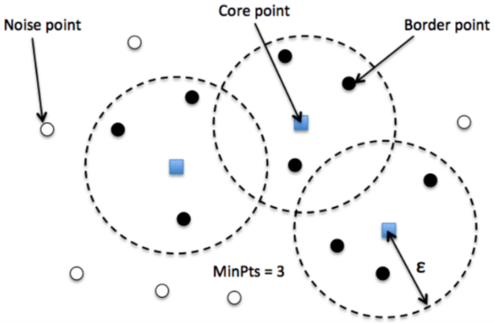
There are three types of points after the DBSCAN clustering is complete:

Slide 82
Core — This is a point that has at least m points within distance n from itself.
Border — This is a point that has at least one Core point at a distance n.
Noise — This is a point that is neither a Core nor a Border. And it has less than m points within distance n from itself.

Slide 83
Algorithm for DBSCAN
The algorithm proceeds by arbitrarily picking up a point in the dataset (until all points have been visited).
If there are at least ‘minPoint’ points within a radius of ‘ε’ to the point then we consider all these points to be part of the same cluster.
The clusters are then expanded by recursively repeating the neighborhood calculation for each neighboring point

Slide 84

Diagram

Slide 85
Parameter Estimation
Every data mining task has the problem of parameters. Every parameter influences the algorithm in specific ways. For DBSCAN, the parameters ε and minPts are needed.
minPts: As a rule of thumb, a minimum minPts can be derived from the number of dimensions D in the data set, as minPts ≥ D + 1. The low value minPts = 1 does not make sense, as then every point on its own will already be a cluster. With minPts ≤ 2, the result will be the same as of hierarchical clustering with the single link metric, with the dendrogram cut at height ε. Therefore, minPts must be chosen at least 3.
However, larger values are usually better for data sets with noise and will yield more significant clusters. As a rule of thumb, minPts = 2·dim can be used, but it may be necessary to choose larger values for very large data, for noisy data or for data that contains many duplicates.

Slide 86
ε: The value for ε can then be chosen by using a k-distance graph, plotting the distance to the k = minPts-1 nearest neighbor ordered from the largest to the smallest value. Good values of ε are where this plot shows an “elbow”: if ε is chosen much too small, a large part of the data will not be clustered; whereas for a too high value of ε, clusters will merge and the majority of objects will be in the same cluster. In general, small values of ε are preferable, and as a rule of thumb, only a small fraction of points should be within this distance of each other.

Slide 87
Distance function: The choice of distance function is tightly linked to the choice of ε, and has a major impact on the outcomes. In general, it will be necessary to first identify a reasonable measure of similarity for the data set, before the parameter ε can be chosen. There is no estimation for this parameter, but the distance functions need to be chosen appropriately for the data set.

Slide 88
Complexity of DBSCAN
Best Case: If an indexing system is used to store the dataset such that neighborhood queries are executed in logarithmic time, we get O(nlogn) average runtime complexity.
Worst Case: Without the use of index structure or on degenerated data (e.g. all points within a distance less than ε), the worst-case run time complexity remains O(n²).
Average Case: Same as best/worst case depending on data and implementation of the algorithm.

Slide 89
Advantage
Disadvantage
DBSCAN does not require one to specify the number of clusters beforehand.
DBSCAN performs well with arbitrary shaped clusters.
DBSCAN has a notion of noise, and is robust to outliers.
DBSCAN cannot cluster data-sets with large differences in densities well, since then the minPts-eps combination cannot be chosen appropriately for all clusters.
Choosing a meaningful eps value can be difficult if the data isn't well understood.
DBSCAN is not entirely deterministic. That's because the algorithm starts with a random point. Therefore border points that are reachable from more than one cluster can be part of either cluster.

Slide 90
Thank You

